Slide 1
Anushka A
FINAL PROJECT
3/21/2024 Annual Review

Slide 2
PROJECT TITLE: Traffic sign recognition using CNN and Keras
3/21/2024 Annual Review

Slide 3


AGENDA
Problem Statement
Project Overview
End Users
Our solution and Proposition
Key Features
Modelling Approach
Results and Evaluation
Conclusion
3/21/2024 Annual Review

Slide 4

PROBLEM STATEMENT
Develop an effective traffic sign recognition system utilizing Convolutional Neural Networks (CNN) and Keras.
3/21/2024 Annual Review

Slide 5
PROJECT OVERVIEW
The objective of this project is to develop efficient traffic sign recognition systems using Convolutional Neural Networks (CNNs) and Keras.
Traffic sign recognition is crucial to maintain road safety, especially in the context of autonomous driving, driver assistance systems, and traffic management.
By utilizing CNNs and Keras, the project aims to build a robust system that can accurately identify traffic signs in real-time scenarios, thereby contributing to enhanced road safety measures.
3/21/2024 Annual Review

Slide 6

WHO ARE THE END USERS?
.
Autonomous Vehicle Manufacturers
Driver Assistance Systems Providers
Traffic Management Authorities
Smart Cities Initiatives
Navigation App Developers
General Public
Law Enforcement
3/21/2024 Annual Review

Slide 7

YOUR SOLUTION AND ITS VALUE PROPOSITION
SOLUTION:
Our solution leverages Convolutional Neural Networks (CNNs) and the Keras framework to develop an efficient traffic sign recognition system.
This system processes real-time traffic sign data captured by cameras or sensors, accurately identifies various types of traffic signs, and provides timely information to users.
VALUE PROPOSITION:
Enhanced Safety: Our system ensures timely detection and recognition of traffic signs, contributing to safer road conditions and reducing the risk of accidents.
Improved Efficiency: By automating traffic sign recognition, our solution optimizes traffic flow, minimizes congestion, and enhances overall transportation efficiency.
Cost Savings: Our system helps minimize costs associated with accidents and traffic disruptions, leading to long-term cost savings for individuals and organizations.
Scalability and Adaptability: The use of CNNs and Keras allows for scalability and adaptability, making our solution suitable for integration into various traffic automation systems and catering to diverse user needs and applications.
3/21/2024 Annual Review

Slide 8

THE WOW IN YOUR SOLUTION
Real-time performance: Our system achieves real-time processing, enabling rapid detection and classification of traffic signs with minimal delay.
High accuracy: Leveraging advanced CNN models implemented with Keras, our solution ensures precise recognition of traffic signs, minimizing false detections and enhancing overall reliability.95% of accuracy.
Efficiency and robustness: Through careful optimization and training, our system maintains high performance across various environmental conditions and traffic scenarios, ensuring consistent performance in real-world applications.
Scalability and adaptability: Designed to be scalable and flexible, our solution can be easily integrated into different platforms and applications, catering to diverse user needs and evolving traffic management systems.
3/21/2024 Annual Review
8

Slide 9
MODELLING
Modeling for the Traffic Sign Recognition System Using CNN and Keras:
Input Data: Gather input images or video frames from diverse sources like cameras, sensors, or pre-recorded video files to feed into the system.
Data Collection: Acquire a diverse dataset of labeled traffic sign images, covering various shapes, colors, sizes, and environmental conditions. This dataset serves as the foundation for training the recognition model.
Data Preprocessing: Prepare the dataset by standardizing image sizes, adjusting brightness and contrast, and removing noise or irrelevant background elements. Additionally, augment the dataset through techniques like rotation, scaling, and cropping to increase its variability and robustness.
Model Architecture Design: Design a suitable deep learning architecture for traffic sign recognition. Convolutional Neural Networks (CNNs) are commonly employed due to their ability to automatically learn hierarchical features from raw image data.
Model Training: Train the chosen CNN model on the preprocessed dataset using techniques like stochastic gradient descent. During training, the model learns to map input images to corresponding traffic sign labels by adjusting its internal parameters based on the provided training data.
3/21/2024 Annual l Review
9

Slide 10
MODELLING
Model Evaluation: Evaluate the trained model's performance using a separate validation dataset. Measure metrics such as accuracy, precision, recall, and F1-score to assess how well the model generalizes to unseen data.
Hyperparameter Tuning: Fine-tune the model’s hyperparameters, such as learning rate, batch size, and network architecture, to optimize its performance further. This may involve techniques like grid search or random search to find the best combination of hyperparameters.
Deployment: Deploy the trained model into real-world applications, such as autonomous vehicles or traffic monitoring systems. Integrate the model into the target environment, ensuring it can efficiently process input images and provide accurate predictions in real time.
Monitoring and Maintenance: Continuously monitor the deployed model's performance and collect feedback from users. Update the model periodically to accommodate changes in traffic signs, road conditions, or environmental factors, ensuring its continued effectiveness over time.
3/21/2024 Anual Review
10

Slide 11
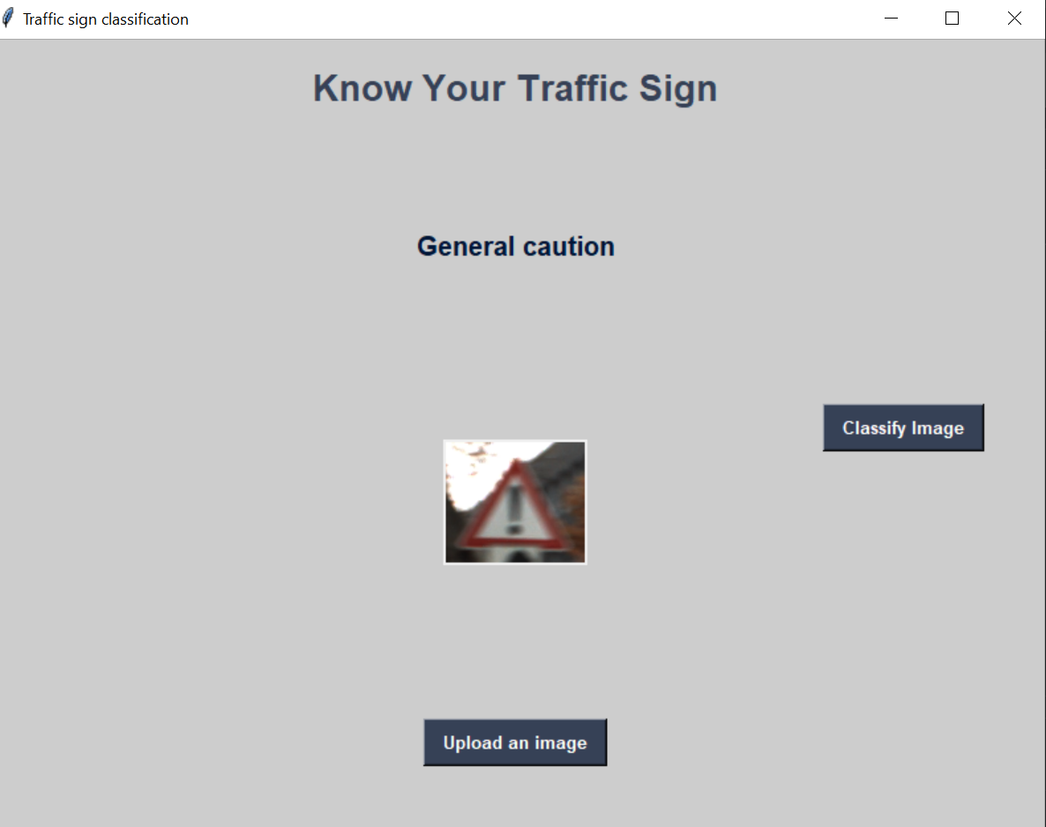
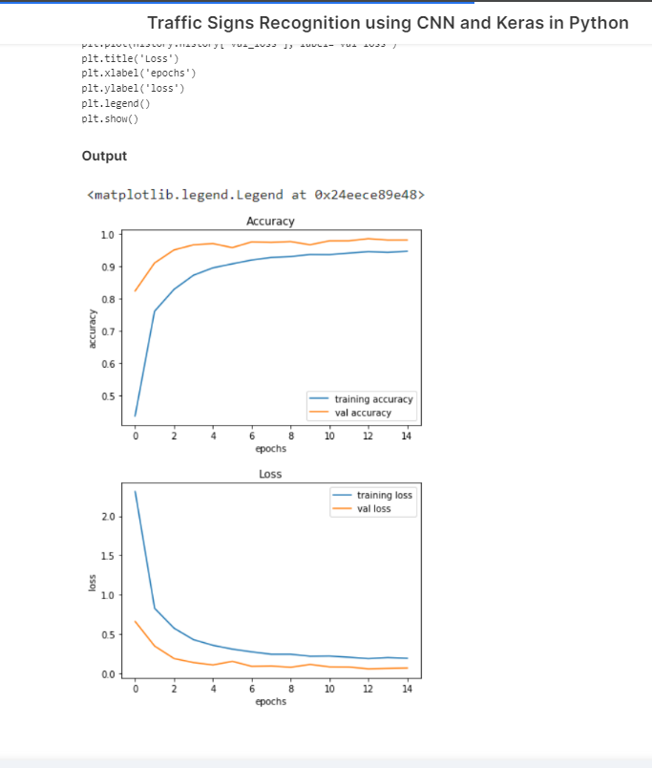
RESULTS
3/21/2024 Annual Review
11

